Slide 1
دورة تطوير تطبيقات الويب باستخدام ASP.Net
يقدمها: عمر عبدالكريم المناخلي
Notes:
(5) Omar Abdelkerim | LinkedIn

Slide 2
Unit 2: User Management

Slide 3

Outlines:
Authentication vs Authorization
Installing ASP.NET Identity
Scaffolding and Exploring Identity Tables
User Registration and Login
Role-Based Authorization
Managing Users and Roles
Customizing the Identity System
Publishing to IIS or Azure

Slide 4
Authentication vs Authorization

Slide 5
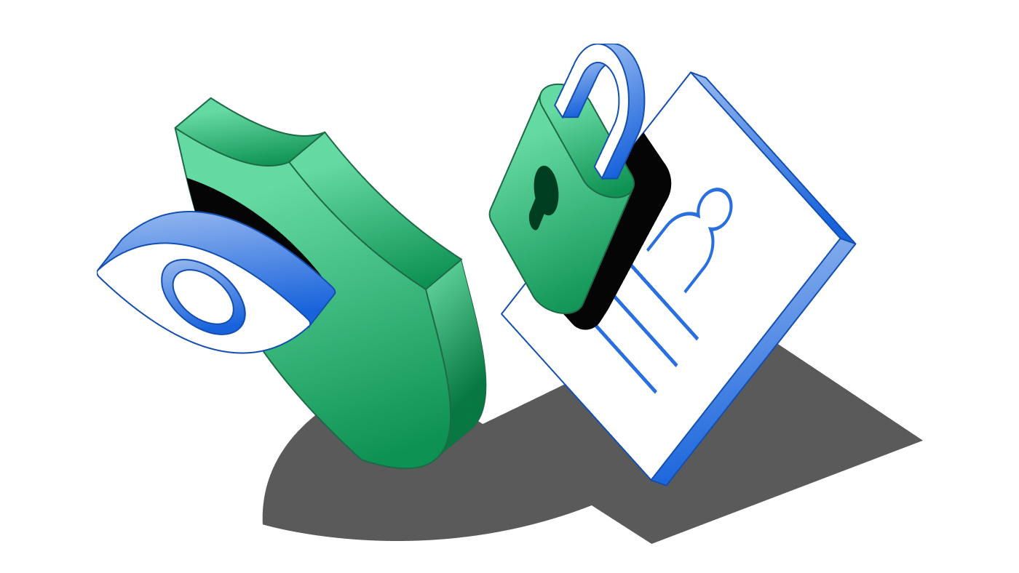
Why Security Matters in Web Apps
Why Do We Need Authentication & Authorization?
  Protect sensitive clinic data (e.g., patient info, appointment details).
  Ensure only authorized roles (Doctor, Receptionist, Admin) can access certain features.
  Prevent unauthorized actions like modifying appointments or accessing system settings.

Slide 6
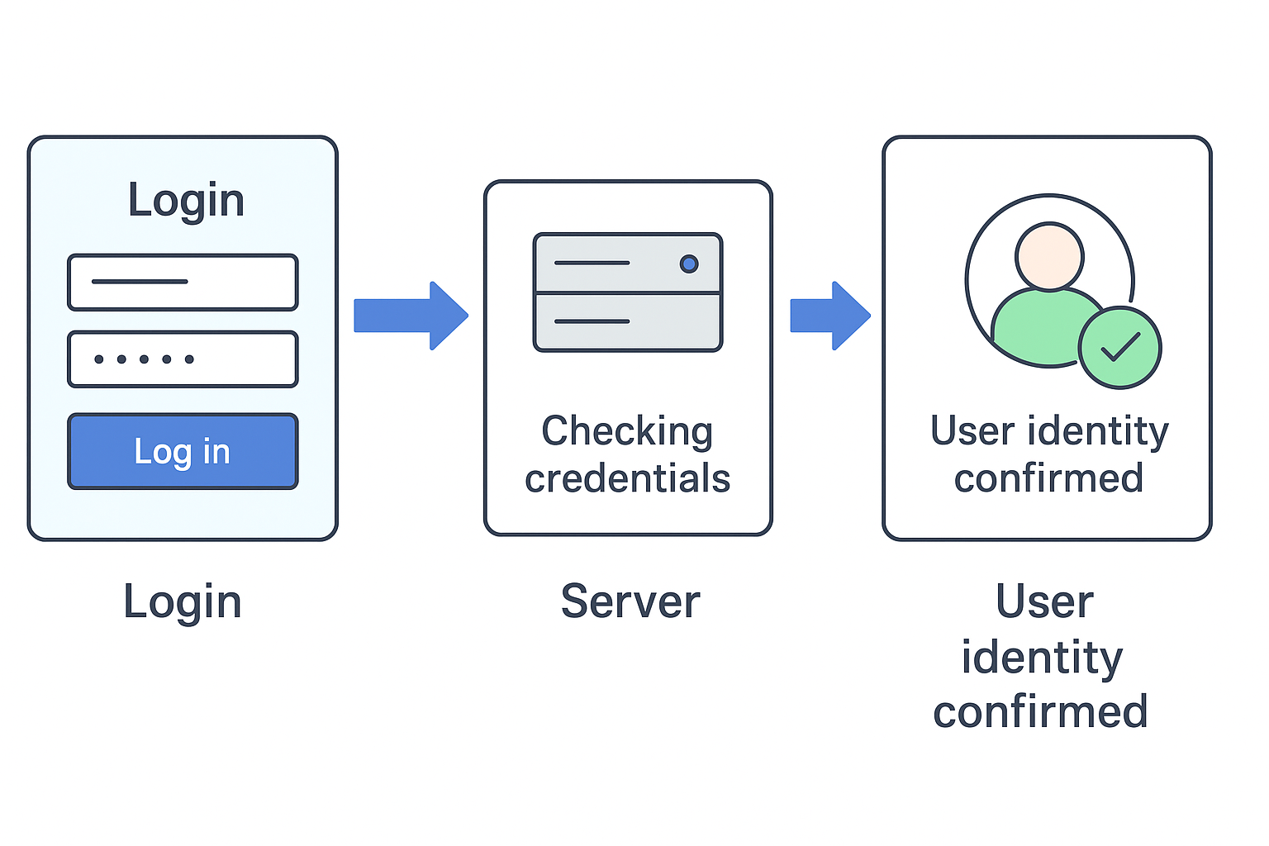
What is Authentication?
Authentication is the process of verifying the identity of a user.
  Answers the question: Who are you?
  Usually involves login credentials (username & password).
  In ASP.NET 8, implemented using ASP.NET Identity.

Slide 7
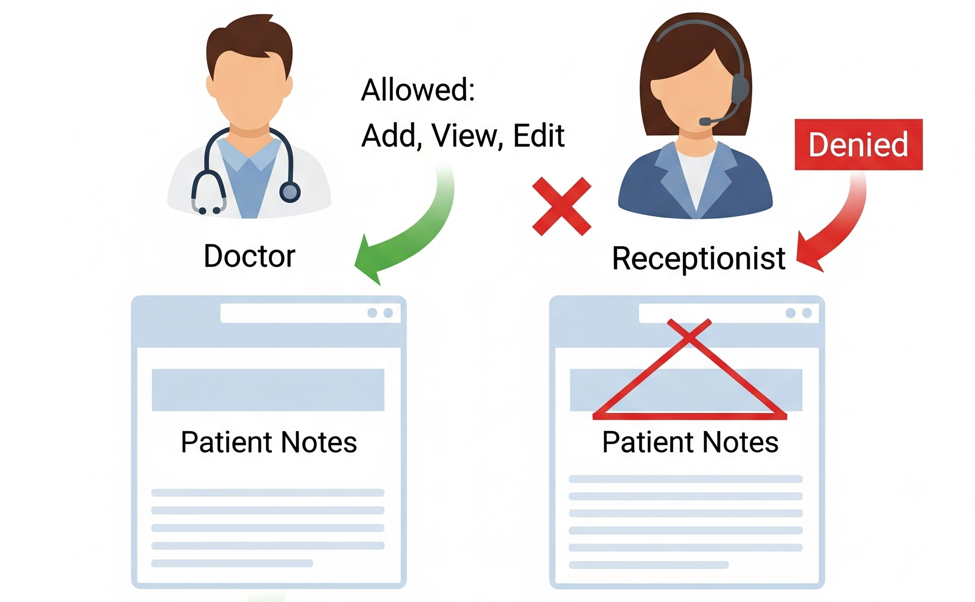
What is Authorization?
Authorization is the process of determining what a user is allowed to do.
  Answers the question: What can you access?
  Based on roles (e.g., Doctor vs Admin).
  Configured using claim, role or policy-based checks in ASP.NET.

Slide 8
Authentication vs Authorization
Feature | Authentication | Authorization
Purpose | Verify identity | Grant/restrict permissions
Occurs When? | Before authorization | After authentication
Controls Access | No | Yes
Technologies | Login system, Identity | Roles, Policies, Claims
Example | Login with email/password | Only doctors can add notes

Slide 9
Real Example: Clinic Appointment System
Scenario:
Omar logs in using his credentials (✅ Authentication)
Omar is a Receptionist, so he can’t manage users (✅ Authorization)

Slide 10
How ASP.NET 8 Handles This
How ASP.NET 8 Implements These Concepts
ASP.NET Identity handles authentication (register, login, cookie/token).
Authorization controlled using:
  [Authorize(Roles = "Doctor")]
  Policies in Program.cs
Integrated with middleware and Identity DB tables

Slide 11
Installing ASP.NET Identity

Slide 12
Overview of ASP.NET Identity
A membership system for authenticating and authorizing users.
Built on top of Entity Framework Core.
Supports roles, claims, external logins, and more.
Comes with default models like IdentityUser, IdentityRole.

Slide 13
Install ASP.NET Identity
Required NuGet package:
  Microsoft.AspNetCore.Identity.EntityFrameworkCore
In application context inherit IdentityDbContext class instead of DbContext class.

Slide 14

Configure Identity Services
Register Identity in the Program.cs

Slide 15
Apply Migrations and Update DB
Create Identity Tables with EF Core
  Add-Migration CreateIdentityTables
  Update-Database
Result: Tables like AspNetUsers, AspNetRoles, AspNetUserRoles, etc.

Slide 16
Action Methods and Routing
URL Path | Controller | Action Method
/Patient | PatientController | Index()
/Patient/Create | PatientController | Create()
/Patient/Edit/5 | PatientController | Edit(int id)
/Patient/Delete/5 | PatientController | Delete(int id)
📌 By default: /ControllerName/ActionName/{id?}

Slide 17
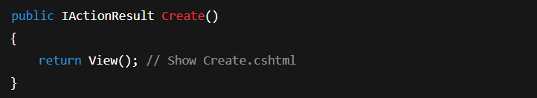
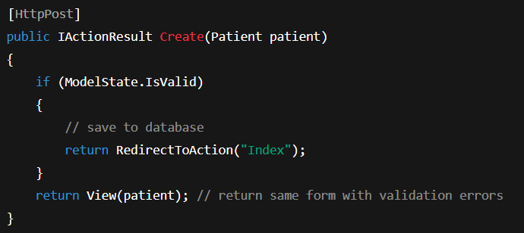
Creating a Basic Action Method
🔧 Display a patient registration form:
📨 Handle form submission:

Slide 18
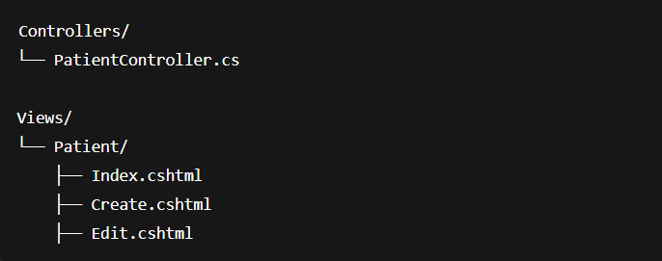
Controller and Views Relationship
📁 Folders should match Controller name
📄 View file names match Action methods

Slide 19
References
https://jonhilton.net/razor-pages-or-mvc-a-quick-comparison/
https://stackify.com/asp-net-razor-pages-vs-mvc

Slide 20
شــــــكــــرًا لكــــــم
THANK YOU

